Slide 1
RRDS 23: UK OTC reg reporting project launch
2 June 2020

Slide 2
Welcome to RRDS 23
Round the table:
Firms: BMO, BNY Mellon, Citi, Credit Suisse, DB, GAM, Goldman Sachs, Invesco, LBG, Morgan Stanley, Pictet, PIMCO, Santander, SEI, TD, UBS
Infrastructure: Accenture, Business Semantics, Capco, DTCC, EY, Fujitsu, LRH, LSEG, Quorsus, SETL, SWIFT
Trade Associations: AFME, ICMA, ISDA, EVIA, FIA, FTC
Regulators: BoE, ECB, FCA
Abbreviated rules of the road:
Chatham House Rule applies
Please introduce yourself when speaking for the first time
No free rides - this does not work if you let others do all the talking
Silence = agreement
All attendees will receive copies of the minutes. Members will receive presentation materials
Survery is live on: www.menti.com code: 76 44 18
Thank you for keeping our trusted community thriving on-line! ​

Slide 3
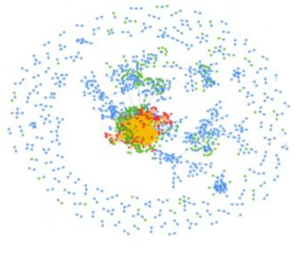
JWG 2020 research agenda
Global not for profit
Lots of reg noise and tech noise
Low awareness
Lots of siloed conversations
2019: Produced 5 white papers and ran 2 webinars
2019: Helped set the public/private sector collaborative agenda
2019: Ran 30+ global workshops with 50+ firms, vendors and regulators in a high-trust environment
Drove the global agenda for AML registry data
Helped shape the global agenda for Transparency 2.0
Operating model requirements for a patchwork of trade, eComms and voice surveillance obligations
2020 Focus
AML/ Tax: 5MLD ꟾ AML action plan ꟾ UK Economic Crime Plan ꟾ Tax
Investor Protection: PRIIPS MiFID III ꟾ Researchꟾ Product Governance/ Info ꟾ Phone recordingꟾ Semi-professionals
Transparency 2.0: Public registries ꟾ Dictionary ꟾ Standards ꟾ Single hub ꟾ MRR
Surveillance: MAD/ MAR II ꟾ Conduct ꟾ Ethics ꟾ SM&CR ꟾ ESG
Market effectiveness: MiFID III ꟾ Trading ꟾ Post trade ꟾ consolidated tape of record ꟾ data cost
Digital supply chains: Op resilience ꟾ 3rd party risk ꟾ Green Finance ꟾ Cyber ꟾ SM&CR ꟾ AI/ Data

Slide 4
Reporting agenda overview
Since 2017, with support from industry SMEs from 30+ firms including we have engaged with the FCA TechSprints, BoE, European and US regulators to help shape the dialogue on the next generation of reporting
Transparency 2.0 is now upon us as:
EU regulators redefine their approach: ROFIEG report, EU €5 Billion Data strategy, Forthcoming Digital Finance strategy/ EU fitness check on reporting; and MiFID III
The UK rolls out Digital Regulatory Reporting, and kicks off a 5-year dialogue on transformation of data collection and defines post Brexit ‘equivalence’
The US CFTC and other global OTC regulators move to standardise their reporting efforts by 20203
This year we have an ambitious agenda which will include alignment to a collective path of action to get from ‘rule book’ to ‘single hub of data’ leveraging new semantic technology and AI
JWG’s RegTech RRDS provide the regulatory intelligence and collaborative, high-trust environment for SMEs to ensure they fully grasp an evolving landscape, develop their heat maps and identify solutions on a regular basis

Slide 5
RRDS Agenda 2020
Month | Meeting Topic | Agenda | Host
9 Jan | RRDS 20: EMIR Refit – DRR + European Data strateg | Key updates to EU/UK regulatory data collection strategies​ A plan for the RegTech Council EMIR Refit interpretation project​ Next steps for the RTC and RRDS in 2020​ | Goldman Sachs
7 Feb | Changing the reporting framework with RegTech | Deploying new reporting tech assets Moving to newly-agreed standards Scaling approaches from lab to shop floor The promise of collaboration, standards and common reference data | Tower Gourman
19 Mar | RRDS 21: EU and UK regulatory data plumbing plans | Key updates to EU/UK regulatory data collection strategies Group discussion of ‘end to end’ vision Key issues, priorities and milestones | Online
30 April | RRDS 22: Jumpstarting the OTC reg reporting 2.0 roadmap | Recap on priority issues and action items Transparency 2.0 target state articulation Potential approaches and priorities | Online
2 June | RRDS 23: UK OTC reg reporting project plan | Key milestones Resource requirements Launch plans | Online
16 July | RRDS 24: UK OTC reg reporting project launch | Terms of reference Key stakeholders Communications | Online
August | RRDS 25: MiFID III transparency and the data agenda | New investment report with 109 data fields for 3rd country firms MiFID III consultation | TBC
Signed up project members to participate in RRDS project workgroups/ meetings

Slide 6
Agenda
16:00 Introductions
16:10 30 April recap
16:20 Proposed scope and key milestones
16:30 Project plan and resource requirements
17:15 Governance, Launch plans and next steps
17:30 End

Slide 7
RRDS 23 survey questions
Engagement model
Disambiguation
Business justification
Resource commitment
Go to www.menti.com and use the code 76 44 18
1
2
3
Grab your phone
Go to www.menti.com
Enter the code above and vote!

Slide 8
RRDS 21-22 conclusions
EU and UK reporting strategy
Though the UK vision is felt to be more comprehensive than Europe’s but 53% believe there is a disconnect between high-level messaging about the desire to ‘simplify’ UK rule books with a detailed data collection drive
A joined-up approach is required to: rule book text (i.e., dictionaries/ glossaries), data model and interpretative standards which will result in lower costs & higher quality outcomes
EMIR Article 9 rewrite is a great opportunity to get OTC data quality issues sorted through upstream alignment of standard texts to a common glossary. The UK ‘EMIR’ technical standards will likely be consistent with other standards across the globe
Target approach
A three-stage ontology-based approach to link the legal obligations (e.g., pricing notation, settlement dates) to a common business view of data requirements in the second stage which enables organisation to map to their IT systems’ reporting artefacts in a third stage
As regulators are now exploring the disambiguation of text via SBVR and aligning to ISO standards, it will be helpful to tie clarifying semantic interpretation to the actual messages used in the industry’s internal systems
industry engagement should be formalised with attention on governance, a secretariat and project office with guidance from the UK regulators.
JWG project + Industry oversight
A March survey showed 60% feel that the project should be moving now to achieve better outcomes in 2021
Project management / secretariat will be funded by subscription to JWG by vendors, consultants, and other service providers (open to all)
Dedicated resource from the firms and some form of engagement from the regulators is critical to the success of the effort

Slide 9
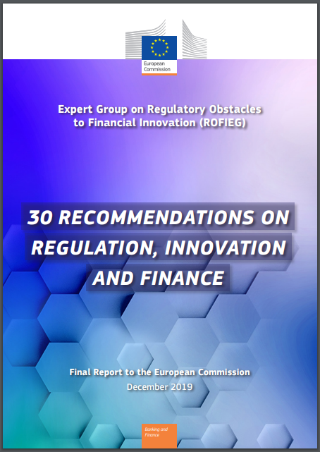
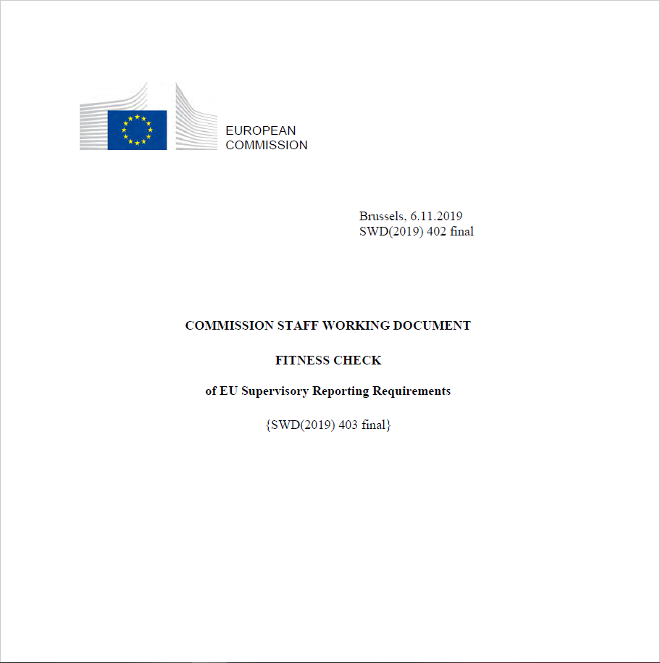
Transparency 2.0 framework
Transparency
Recession countermeasures?
Transparency 2.0 vision reset?
Write the rules right
Get the data correct
Dictionary
Machine readable Rule books
Common Interpretation
Standards
Public registries
Single Hub
Express reporting requirements
Input/ Output layer
Data processing strategy
Legislative process and instruments
Inconsistent definitions / formats
Common dictionary/ standards
Implementation planning/timing
Data model
Operational standards
Code
CPMI/ IOSCO OTC message standards
Who reports what to whom
Summary of statistics reporting requirements
Single data hub
CMU: MiFID III ꟾ Trading ꟾ Post trade ꟾ consolidated tape of record ꟾ data cost
Establish semantic references
Interpretation
Post Brexit UK: New reporting plumbing infrastructure
LEI Strategy
CPMI/IOSCO OTC Standards
EU data strategy: Digital Finance:
Standardisation of legal terminology and classification of actors, services, products and processes
Human- and machine-readable legal and regulatory language
Regulatory Clearing House
‘Pro-competitive’ reporting rules
Improving market transparency
Cloud Strategy
Concentration risk
User rights to stay in control
Firms’ internal IT governance
Disambiguated EMIR Provisions, Definitions & Report Data Contents
UK obligation disambiguation + CDM population of test scenarios
FCA/ BoE DRR
Machine Readable and Executable Reporting Requirements - Proof of Concept (PoC) for EMIR Refit
EMIR Art. 9 DRR project: Test scenarios, report output, reporting logic on the cross-industry association CDM

Slide 10
Why run a JWG EMIR Refit programme
Characteristics
High degree of specificity required in mutual interpretation
Big focus on EMIR data quality in 2020
Head-off SFTR-like 2021 implementation panic
Align 2021 EU/UK rule books and technical standards
Align with CFTC Part 43 & 45
Difficulty of other collaborative options
Regulators: independence challenges
Vendors: as above + open source
Firms: buy-side/ sell-side challenge
Trade association collective: as above + PMO challenge
Standards bodies: as above + governance issues
Role of JWG
Safe space: RegTech and business SMEs without a consulting or legal agenda
No conflicts: JWG does not sell a regulatory reporting product
Network: Regulators, data standards, semantic standards, TAs, firms, vendors
Membership based, fit for purpose commercial model
JWG is uniquely positioned as the ‘safe space’
Mutualized interpretation ꟾ open-source software ꟾ formal governance ꟾ open public-private initiative

Slide 11
Project scope
Sprint 0:
Working group protocols/ logistics (e.g., doc sharing)
Technical platform
Communications/ Feedback loops
Priorities and sprint resourcing by asset class
Governance/ steerco arrangements
Sprint 1: standalone flow derivative e.g.,
Baseline modelling standards
Business/ product modelling for either: a vanilla IRS; an Fx swap; an equity swap or; a CFD
First review of test cases
Sprint 2: more complex product e.g.,
Basis swap; or CDS
First review of test cases
Sprint N
…
Test MER logic
Regulatory Corpus
Report Output
Project into documents for BAs
Reporting Logic
The RRDS proposes to use:
Take 1 rule and assess all logical permutations
Rosetta Core
(the native ISDA CDM editor)
Best Practices
to turbo-charge the delivery cycle
SMEs
Test Scenarios
Market Practice
Repeat
Working Group Validation
Prepare visual materials
Agile process envisioned:
tight loop (1-2 weeks), with scope increasing at each iteration
each iteration produces “shippable” (ISDA CDM) output that firms can use directly

Slide 12
Target state: 3 tier semantic model
Legal domain: Science of law
Unambiguous business view of data requirement: Science of terminology
Physical data dictionaries & artefacts
Reporting data Glossaries
Reporting artefacts
Legal glossary
Consistent and compliant data artefacts
Reporting artefacts
EMIR Refit regulation
Core Financial Ontology
SBVR interpretation of EMIR reporting obligations
Other financial glossaries
Other regulatory reporting content glossaries
Other data artefacts
Purpose for doing
Optimization goal
Context/ scope of applicability
Language of people/ business
Definite descriptions of objects
Clarifying concepts/ definitions
Information processing
Model of information/ data
Data format/ recording obligations
Ontology based ꟾ disambiguated semantics ꟾ agreed definitionsꟾ linked architecture

Slide 13
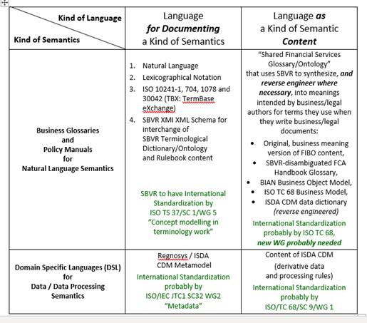
Fast-evolving rule book standards need to be considered
What is SBVR?
What Regulatory Problem does SBVR Address?
How does SBVR Remove Ambiguity from Regulatory Sentences?
How does SBVR Remove Ambiguity from Glossary Entries?
How does SBVR Remove Ambiguity from Regulatory Report Data Requirements?
What are SBVR Clause Skeletons (aka ‘verb concepts’) -- and why are they so Important?
What is the difference between Machine-readable and Machine-understandable?
How can SBVR authoring tools use Natural Language Grammar to make drafting unambiguous sentences & definitions easy?
How to use SBVR?
Who uses SBVR today, and how to they use it?
How might the life of a lawyer or policy drafter change if they were to use an SBVR authoring tool?
What needs to be done to make the Glossary unambiguous?
What needs to be done to make Regulatory Report Data Requirements unambiguous?
What SBVR-compliant unambiguous document and glossary authoring tools are available, and who publishes them?
What SBVR resources exist to learn and practice writing unambiguous sentences & creating unambiguous glossary entries?
(CTRL+Click on Link to access answer slides)
(CTRL+Click on Image to the left
to access document )

Slide 14
Reference Schemes to connect General Concepts with Names of Individual Concepts
Needed for all general concepts whose instances need to be identified by the business
Example:
rental car
Definition: car that is owned by EU-Rent and is used for rentals
Reference Scheme: VIN
car model
Definition: Type of car supplied by a manufacturer with a standard specification that includes body style, engine size, and fuel type(s).
Note: EU-Rent bases its model names on those assigned by the car manufacturers, but sometimes has to extend them to distinguish models, for example with/without air conditioning.
Reference Scheme: manufacturer code, model id

Slide 15
Agenda
16:00 Introductions
16:10 30 April recap
16:20 Proposed scope and key milestones
16:30 Project plan and resource requirements
17:15 Governance, Launch plans and next steps
17:30 End

Slide 16
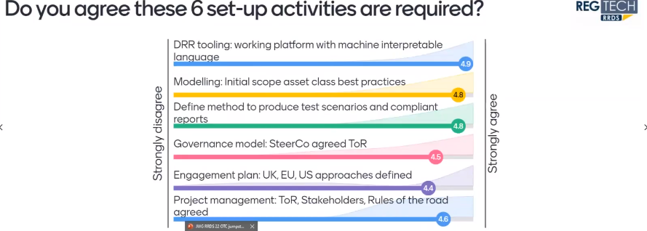
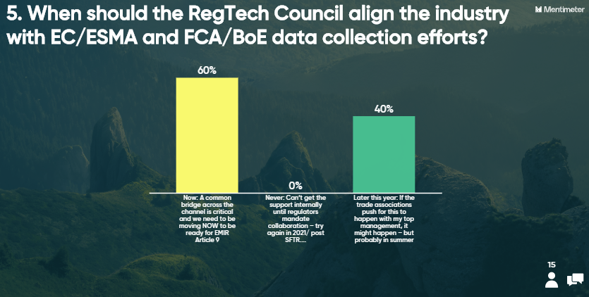
Engagement approach

Slide 17
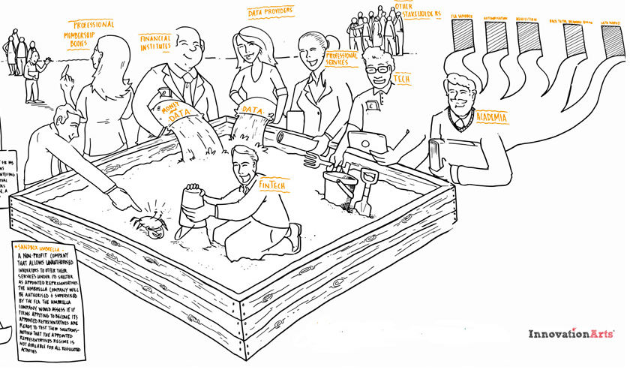
DRAFT governance framework
Executive oversight committee e.g.:
...
Governance: Vision, oversight and steering
Oversee delivery of RRDS EMIR project
Align with trade association work to establish best practices
Help overcome obstacles
Regulators ꟾ Financial Institutions ꟾ Market Infrastructure
Metrics
Feedback
Problem statements
Results & qualification
The RRDS secretariat: tangible output
The public / private ‘safe space’
Deliver to the terms of reference
Helps mobilise resources, including non-RRDS members
Assesses the quality and value of work for the industry
Drives communication and engagement across the financial firms
Financial Institutions ꟾ Market Infrastructure ꟾ Technology ꟾ Service providers
...
Sandbox?
RegTech test environment: reusable assets
Reusable technology to support collaborations
Reusable data sets to support tests and validate results
Resources to maintain environment and support collaborations
Package & curate assets
Drive communication
This programme needs to be aligned to current books of work with active regulatory participation
Environments, data and resources to support collaborations

Slide 18
Resource model
RRDS EMIR Refit SteerCo
Sandbox?
RTC service / technology firm volunteers
Member firms: Responsible for planning, mobilising resources, and to complete final deliverables
Project Manager: from an RTC service provider or firm
Other TA SMEs
Firm SMEs 0.5 days a week
Business Analyst from a member firm or service provider
ISDA SMEs
Regulator SMEs 0.5 days a week
Technician to support work on the Common Domain Model and Domain Specific Language
Requirement for FCA/ESMA?
Source: RegTech Council 2020

Slide 19
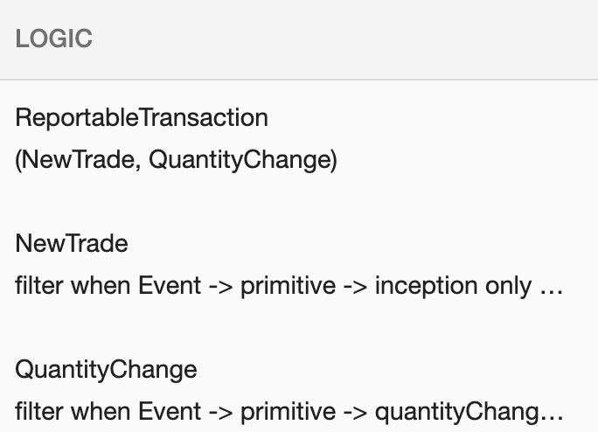
A focus on reporting logic will deliver meaningful test scenarios
Current industry implementations leave the “tricky part” = actual operationalisation for last
RTS + Interpretation
Done by each firm via in-house resources, contractors and 3rd party vendors
High cost, lower quality result
Test Scenarios
Reporting Logic
Report Output
Best Practices as “Views”
Directly extracted from the machine-executable model
Downloadable in any other formats: PDF, Excel etc.
Table view aligned onto ESMA RTS
Machine-Executable Interpretation
Rule interpretation deemed only as good as its operationalisation and testing
The real painful part is mutualised
Proposed = an efficient ”implementation first” process with embedded test-driven practices
Source: RegTech Council 2019

Slide 20
Project approach
JWG RRDS UK OTC project approach
Steps
Activity | Start-up | Sprint 1 Deliverable
DRR tooling | Select machine interpretable language | Working platform
Disambiguation | SBVR observation of business interpretation | Disambiguating regulatory text and link regulatory text/glossary to CDM
Modelling | Define a working approach/ prioritization (e.g., reconciled fields) | Model initial scope asset class best practices and publish first model
Data quality testing | Establish a test harness and data strategy & paperwork | Define method to produce test scenarios and compliant reports
Governance model | Define governance model/ engagement with FCA/ BoE | Hold initial SteerCo meetings
Engagement | Define communication plan and engagement model with EU/ US | Initial communications
Project management | Terms of Reference, Stakeholder management | Agreements, Rules of the road
Resources
Regulator | Firms/ CCPs | TR/ Tech
RegTech team input | Tech/ Data SMEs | Data SMEs
Policy team input + Semantic SME (SBVR)
Policy team input | Business SME / TAs | Tech SMEs
RegTech team input? | Tech/ Ops | Tech SMEs
RegTech team engagement | SteerCo | Observers
None | JWG | None
None | JWG | None

Slide 21
RRDS Agenda 2020
Month | Meeting Topic | Agenda | Host
9 Jan | RRDS 20: EMIR Refit – DRR + European Data strategy | Key updates to EU/UK regulatory data collection strategies​ A plan for the RegTech Council EMIR Refit interpretation project​ Next steps for the RTC and RRDS in 2020​ | Goldman Sachs
7 Feb | Changing the reporting framework with RegTech | Deploying new reporting tech assets Moving to newly-agreed standards Scaling approaches from lab to shop floor The promise of collaboration, standards and common reference data | Tower Gourman
19 Mar | RRDS 21: EU and UK regulatory data plumbing plans | Key updates to EU/UK regulatory data collection strategies Group discussion of ‘end to end’ vision Key issues, priorities and milestones | Online
30 April | RRDS 22: Jumpstarting the OTC reg reporting 2.0 roadmap | Recap on priority issues and action items Transparency 2.0 target state articulation Potential approaches and priorities | Online
2 June | RRDS 23: UK OTC reg reporting project plan | Key milestones Resource requirements Launch plans | Online
16 July | RRDS 24: UK OTC reg reporting project launch | Terms of reference Key stakeholders Communications | Online
August | RRDS 25: MiFID III transparency and the data agenda | New investment report with 109 data fields for 3rd country firms MiFID III consultation | TBC
Signed up project members to participate in project workgroups/ meetings

Slide 22
Next SIG agendas
To participate in any of JWG’s RegTech special interest groups or for more information about the RegTech council, please email Corrina on Corrina.stokes@jwg-it.eu
Upcoming dates for your calendars:
Top priority controls (MAR/ MiFID II)
Key guidance issues for consideration
Key stakeholder engagement
UK OTC reg reporting project launch
16 July
Sprint 1: MAD/R & MiFID II
9 July
Sprint 2: key issues: MAD/R & MiFID II
11 August
‘Spring 2020’ MAR Consultation results & MiFID III
Top priority obligations
Key guidance issues for consideration

Slide 23
Thank you
www.regtechfs.com
www.jwg-it.eu/collaboration
www.RegDelta.com
Intelligence
Collaboration
Actionable insight
Call us:
+44 20 7870 8004
info@jwg-it.eu
www.jwg-it.eu
@jwg_group
/jwg-group-ltd

