Slide 1
RRDS 24: UK EMIR DRR project launch
16 July 2020

Slide 2

Welcome to RRDS 24
Round the table:
Firms: BMO, BNY Mellon, Citi, Credit Suisse, DB, GAM, Goldman Sachs, HSBC, Invesco, LBG, Morgan Stanley, Pictet, PIMCO, Soc Gen, TD, UBS
Infrastructure: Accenture, Bloomberg, Business Semantics, Capco, CGI, DTCC, EY, LRH, LSEG, SETL, SWIFT
Trade Associations: AFME, ISDA, EVIA, FIA
Regulators: BoE, FCA
Abbreviated rules of the road:
Chatham House Rule applies
Please introduce yourself when speaking for the first time
No free rides - this does not work if you let others do all the talking
Silence = agreement
All attendees will receive copies of the minutes. Members will receive presentation materials
Survey is live on: www.menti.com code: 25 99 39 - https://www.menti.com/r98zrh8gs5
Thank you for keeping our trusted community thriving on-line! ​

Slide 3


































JWG reporting discussion 2020 participants
Producing high-quality EMIR Refit data at a lower price point for the industry, based on “digitising” best practices
Outputs
EMIR Refit DRR project
Best practices. EMIR Best Practices matrix expressed in both natural and machine-readable language
Machine executable rules (MER). A revised Common Domain Model directly executable to compute report from source transactions
Machine-readable test scenarios. A suite of test case transactions represented as CDM objects and their expected output.
Since 2017 JWG has convened a Regulatory Reporting and Data Special (RRDS) interest group with industry SMEs. The group creates a safe space for private and public sector dialogue on a collaborative path for new reporting RegTech with open source standards.
Financial institutions, Market Infrastructure, Technology and service providers will provide SMEs and managers. JWG will run the secretariat and provide the programme office

Slide 4
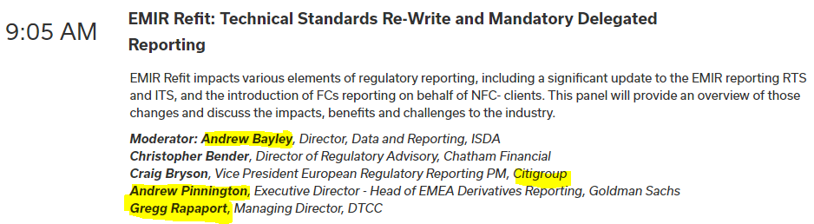


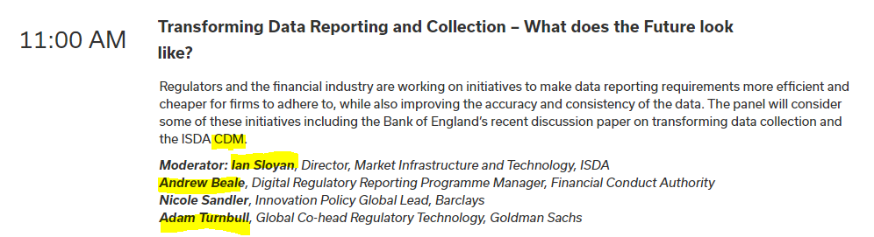
A good time to be discussing DRR

Slide 5
RRDS Agenda 2020
Month | Meeting Topic | Agenda | Host
9 Jan | RRDS 20: EMIR Refit – DRR + European Data strateg | Key updates to EU/UK regulatory data collection strategies​ A plan for the RegTech Council EMIR Refit interpretation project​ Next steps for the RTC and RRDS in 2020​ | Goldman Sachs
7 Feb | Changing the reporting framework with RegTech | Deploying new reporting tech assets Moving to newly-agreed standards Scaling approaches from lab to shop floor The promise of collaboration, standards and common reference data | Tower Gourman
19 Mar | RRDS 21: EU and UK regulatory data plumbing plans | Key updates to EU/UK regulatory data collection strategies Group discussion of ‘end to end’ vision Key issues, priorities and milestones | Online
30 April | RRDS 22: Jumpstarting the OTC reg reporting 2.0 roadmap | Recap on priority issues and action items Transparency 2.0 target state articulation Potential approaches and priorities | Online
2 June | RRDS 23: UK OTC reg reporting project plan | Key milestones Resource requirements Launch plans | Online
16 July | RRDS 24: UK OTC reg reporting project launch | Terms of reference Key stakeholders Communications | Online
October | RRDS 25: MiFID III transparency and the data agenda | New investment report with 109 data fields for 3rd country firms MiFID III consultation | TBC
Signed up project members to participate in RRDS project workgroups/ meetings

Slide 6
Agenda
Progress update
Plan & potential barriers
Governance
Business case
Next steps

Slide 7

RRDS 24 survey questions
Potential barriers
Biggest benefits
Project timing
Go to www.menti.com and use the code 25 99 39
1
2
3
Grab your phone
Go to www.menti.com
Enter the code above and vote!

Slide 8
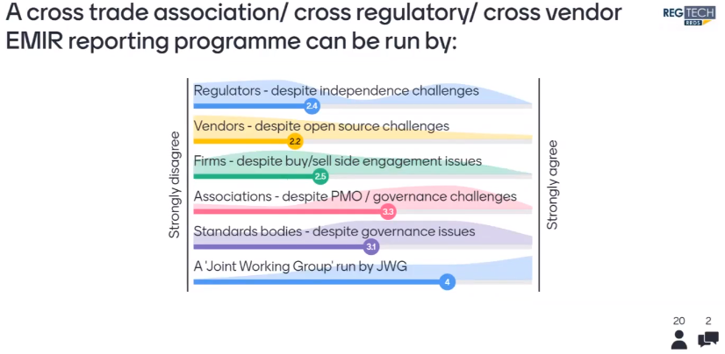
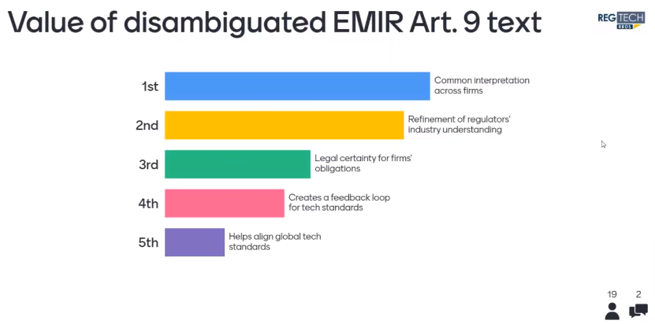
We are here to get more value from regulatory reporting

Slide 9
Recap: EMIR Refit DRR project
What: A collaborative project to use new technology to take away OTC reg reporting headaches in time for 2021 EMIR refit
Why: We have an opportunity to produce high-quality EMIR Refit data at a lower price point for the industry, based on “digitising” best practices
Why now: Return on investment for those at the table from the start will be high as strategic dialogues can begin, objectives aligned, and offerings architected to new standards that will be required by in firms by Q1 2021
How: An open and transparent project to deploy new digital regulatory reporting technologies to link ambiguous legal obligations to a business view of data requirements which are mapped to physical IT systems
Who: This project will be governed by trade bodies, observed by regulators, resourced by financial firms and their providers, and run by JWG
So what: Digitized best practices, test data and code will increase data quality, cut costs, reduce implementation risk and create a strategic data dialogue
Costs: Financial institutions (firms) will contribute SME resources, project fees are required from providers
When: We are mobilizing this summer and the first project meetings will be scheduled after the next JWG RRDS meeting on 16 July
Risks
Requirements
Time
Strategy
Standards
Quality
Overhead
Dialogue

Slide 10
Progress since 2 June RRDS meeting
Planning
  1:1 meetings with ISDA + 5 firms to detail project workplan proposal (shared today)
  Developed resource estimates and refined deliverables
  Requested & received 1 programme management/ BA proposal
  Defined go/ no-go mechanics
Governance
  10 June FCA, BoE, ISDA meeting to discuss project observation
  2 July project update to EC, ECB, ESAs at Frankfurt Group Meeting
  16 July BoE, FCA follow-up with commitment to a form of words by 29 July
  EC meeting to explore possible synergies with EMIR MRER project in progress
Business case/ funding
  Refined benefits table
  Set prices for TRs, CCP, Service providers
  Circulated executive summary of the project to key stakeholders in firms + TRs
Standards
  19 June ISO TC 68 AG2 / BoE standards discussion for regulatory reporting
  1 July SWIFT, BIAN, ISO TC 37, ISDA Standards Gaps and opportunities meeting to identify potential models of leveraging multiple industry standards for EMIR Refit regulatory reporting
  July – SBVR/IDSA EMIR regulatory text disambiguation and tooling conversations

Slide 11
Agenda
Progress update
Plan & potential barriers
Governance
Business case
Next steps

Slide 12
Detailed plan
Focused plan to make the best use of precious resource from firms and their suppliers
We are able to execute the full OTC product set in 9 months
Most complex asset classes will be saved for last to leverage strong foundations
Dedicated project manager and BA will support efforts across all asset classes
Need to get going this summer to hit EMIR implementation targets

Slide 13

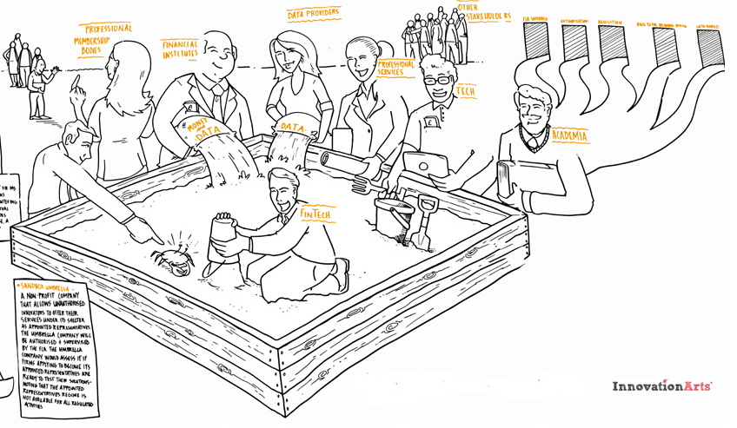



Project approach overview
Test MER logic
Regulatory Corpus
Report Output
Project into documents for BAs
Reporting Logic
The RRDS proposes to use:
Take 1 rule and assess all logical permutations
Rosetta Core
(the native ISDA CDM editor)
Best Practices
to turbo-charge the delivery cycle
SMEs
Test Scenarios
Market Practice
Working Group Validation
Prepare visual materials
Package & curate assets
Drive communication
Prove scalability
Repeat
Agile process envisioned:
tight loop (1-2 weeks), with scope increasing at each iteration
each iteration produces “shippable” (ISDA CDM) output that firms can use directly
Q4
Q1
Q2
Q3
Q4
2019
Go-live
Model maintenance
2020

Slide 14





Potential road blocks: summary
Firms don’t commit resource
Lack of supply chain interest
Regulatory distance from the table
Standards squabbling
Trade association hiccups

Slide 15
Potential roadblock: Firm engagement
Do we have enough commitment from enough firm senior management?
Are buy and sell side firms represented?
Is it high enough priority given Brexit, COVID, etc.
Is the CDM aligned with the IT strategies within the firms
Will CDM be necessary to:
  Meet ESMA demands for data quality
  ‘replay’ all open transactions
  align to a possible new ISO message to the TRs

Slide 16





Target state: 3 tier semantic model
Legal domain: Science of law
Unambiguous business view of data requirement: Science of terminology
Physical data dictionaries & artefacts
Reporting data Glossaries
Reporting artefacts
Legal glossary
Consistent and compliant data artefacts
Reporting artefacts
EMIR Refit regulation
Core Financial Ontology
SBVR interpretation of EMIR reporting obligations
Other financial glossaries
Other regulatory reporting content glossaries
Other data artefacts
Purpose for doing
Optimization goal
Context/ scope of applicability
Language of people/ business
Definite descriptions of objects
Clarifying concepts/ definitions
Information processing
Model of information/ data
Data format/ recording obligations
Ontology based ꟾ disambiguated semantics ꟾ agreed definitionsꟾ linked architecture

Slide 17
Potential roadblock: supplier engagement
Will suppliers simply sit it out until the end and attempt to free-ride causing programme halt?
What is the advantage for those at the table?
Is DRR with CDM a top board-level priority?
Can we scale the investment beyond the UK to EU and other reporting markets?
Are there enough resources to manage all the global OTC reporting demands?

Slide 18
There are multiple benefits for all stakeholders
EMIR Refit DRR project benefits by stakeholder
Benefits | Regulator | Firm | Trade Assoc | TR & CCP | Tech/ data Vendors | Services
Mutualise the interpretation and testing framework |  | ☼ | ☼ | ☼
Streamlines firms’ technical requirement generation |  |  |  | ☼ | ☼ | ☼
Enables vendors/ service provider offerings to scale |  |  |  | ☼ | ☼ | ☼
Decrease time to market and lower operational risk |  | ☼ |  | ☼ | ☼
Set data quality expectations | ☼ | ☼ |  | ☼ | ☼ | ☼
Improves communication / feedback loop during implementation | ☼ | ☼ | ☼ | ☼
Reduced overhead of industry calls |  | ☼ | ☼ | ☼ | ☼
Creates a strategic dialogue about future data needs | ☼ | ☼ | ☼ | ☼
Help shape future reporting standards | ☼ | ☼ | ☼ | ☼ | ☼ | ☼
Provide input to global OTC CDE implementation | ☼ | ☼ | ☼ | ☼
Why now: Return on investment for those at the table from the start will be high as strategic dialogues can begin, objectives aligned, and
offerings architected to new standards that will be required by in firms by Q1 2021

Slide 19
Potential roadblock: standards
Will the investment in CDM fit with ISO20022 needs?
What impact would Europe’s standard message from firms to TRs have?
Who decides the ‘right DRR standards stack’?
Will we have a common approach to glossary/ dictionary tooling?
Are SBVR and CDM part of the ISO 20022 roadmap like the DPM?

Slide 20
Potential roadblock: governance
What structure/ form will the governance take?
Are all relevant trade associations able to participate in the cross-trade governance committee?
How is the open source agreement for CDM structured?

Slide 21





Governance framework
Steering committee
...
Governance: Vision, oversight and steering
Oversee delivery of RRDS EMIR project
Align with trade association work to establish best practices
Help overcome obstacles
Regulators ꟾ Financial Institutions ꟾ Market Infrastructure
Metrics
Feedback
Problem statements
Results & qualification
The RRDS EMIR secretariat: tangible output
The public / private ‘safe space’
Deliver to the terms of reference
Helps mobilise resources, including non-RRDS members
Assesses the quality and value of work for the industry
Drives communication and engagement across the financial firms
Financial Institutions ꟾ Market Infrastructure ꟾ Technology ꟾ Service providers
...
Sandbox?
RegTech test environment: reusable assets
Reusable technology to support collaborations
Reusable data sets to support tests and validate results
Resources to maintain environment and support collaborations
Package & curate assets
Drive communication
This programme needs to be aligned to current books of work with active regulatory participation
Environments, data and resources to support collaborations

Slide 22
Potential roadblock: regulatory engagement
Are the BoE and FCA able to formally observe the project?
How will interaction with the EC / ESMA MRER project to ‘write the EMIR standards right’
What is the approach to engage CFTC efforts?
Machine Readable and Executable Reporting Requirements - Proof of Concept (PoC) for EMIR Refit

Slide 23
Project approach
JWG RRDS UK OTC project approach
Steps
Activity | Start-up | Sprint 1 Deliverable
DRR tooling | Select machine interpretable language | Working platform
Disambiguation | SBVR observation of business interpretation | Disambiguating regulatory text and link regulatory text/glossary to CDM
Modelling | Define a working approach/ prioritization (e.g., reconciled fields) | Model initial scope asset class best practices and publish first model
Data quality testing | Establish a test harness and data strategy & paperwork | Define method to produce test scenarios and compliant reports
Governance model | Define governance model/ engagement with FCA/ BoE | Hold initial SteerCo meetings
Engagement | Define communication plan and engagement model with EU/ US | Initial communications
Project management | Terms of Reference, Stakeholder management | Agreements, Rules of the road
Resources
Regulator | Firms/ CCPs | TR/ Tech
RegTech team input | Tech/ Data SMEs | Data SMEs
Policy team input + Semantic SME (SBVR)
Policy team input | Business SME / TAs | Tech SMEs
RegTech team input? | Tech/ Ops | Tech SMEs
RegTech team engagement | SteerCo | Observers
None | JWG | None
None | JWG | None

Slide 24
Agenda
Progress update
Plan & potential barriers
Governance
Business case
Next steps

Slide 25
Roles & responsibilities
Role | Responsibilities | Assumptions | Sources | Funding
Governance | Agenda Deliverable review/ release approval Programme oversight | Chaired according to current ISDA reporting framework | ISDA, FIA, et al | Trade Associations
Product SMEs | Development of agreed data requirements / definitions & test cases Resolving open issues in a collaborative manner | One SME will act as the sprint lead and be responsible for the schedule and organising meetings & workshops Regulator support required | Firms + Tech vendors + Infrastructure SBVR expert + Regulators | Firms/ vendors/ infrastructure
Project manager | Develop and oversee sprint methodology Deliverable QA Issue management | Wide domain expertise required Part time | Consultancy | Project fees
Project BA | Document sprint on CDM tool Ensure quality across sprints Completes deliverables Peer reviews | Some domain expertise required Knowledge of Common Domain Model preferred Mostly full time | Consultancy/ Vendor | Project fee
Semantic BA | Sits in on Product SME sprints Disambiguates rule book & builds glossary |  | Consultancy/ Vendor | TBD?
Software tooling | Provide technical support to sprints Supports completion of final deliverables, both in terms of CDM update and Word / PowerPoint documents | Licenses to be covered by trade associations Expert in Common Domain Model Part time More intensive to start | RegTech co | Trade associations
Hosting / sandpit | Enable access to results in open environment to members and non-members | Access to regulatory sandboxes Access to commercial PoCs | Hosting providers | Hosting providers
Secretariat | Governance liaison/ minutes Communications Issue management Logistics/ infrastructure Commercials/ agreements | Membership agreements Anticompetition protocol | JWG | Project fees

Slide 26













Resource model
  RRDS EMIR Refit SteerCo
Sandbox?
Service / technology firm volunteers
  Member firms: Responsible for planning, mobilising resources, and to complete final deliverables
  Project Manager
Firm SMEs 0.5 days a week
Business Analyst
Regulatory SMEs Ad hoc
Trade Association
SMEs
Source: RegTech Council 2020

Slide 27
Agenda
Progress update
Plan & potential barriers
Governance
Business case
Next steps

Slide 28
EMIR refit project business value proposition
Artefact | Benefit | Current | Value Est.
Best Practices | Mutualise cost of interpretation Consolidated and version-controlled output = usable – e.g. can directly feed into firms’ documentations | Duplicate internal & external spend on SME services Disparate artefacts in non-digital formats | $200K-500K
Test Scenarios | Enable accurate implementations Directly usable as part of firms’ QAT / TDD processes | No homogeneous testing framework across the industry High risk of operational mistakes | $1M-3M
Machine-Executable Rules | Suppress need for firms’ duplicate build Full implementation traceability back to rule-book | Each firm maintains non-differentiating tech stack No ability to evidence compliance | $5M-10M
INCREASING BENEFIT
ORDER OF DEVELOPMENT

Slide 29
TR/CCP, vendor, service provider fees
 | RRDS membership | EMIR project membership
Summary | JWG RegTech SIGs provide a collaborative, high-trust environment for SMEs from the sell-side, buy-side and vendors to identify key challenges and identify solutions on a regular basis | Collaborative project to use new technology to take away OTC reg reporting headaches for the industry in time for 2021 EMIR refit
Services | Global regulatory imitative tracking Global regulatory reporting roadmap analysis Crowd sourcing strategic insight Heat mapping issues and priorities Obtaining consensus cross industry sectors | Project governance Communications Project execution Project IP Test harness/ Sandbox
Frequency | 8-10 meeting per year Annual event | 9-month project
Deliverables | Membership to online portal Analysis and surveys Formal minutes Discounted event fees | Machine readable best practices Machine executable rules Machine-readable test scenarios Common domain model outputs Sandbox access
Fee by vendor size
Large – 1,000+ | £12,000 pa | £30,000
Medium 250-999 | £9,000 pa | £20,000
Small – less than 250 | £5,000 pa | £10,000 pa
EMIR Refit DRR project
Note: prices exclude VAT
Project fees may be reduced in line with resources dedicated to the EMIR project

Slide 30
Agenda
Progress update
Plan & potential barriers
Governance
Business case
Next steps

Slide 31
Next steps
JWG RRDS SIG agenda 2020
EMIR Refit DRR project
Month | Meeting Topic | 2020 Agenda
9 Jan | RRDS 20: EMIR Refit – DRR + European Data strategy | Key updates to EU/UK regulatory data collection strategies​ A plan for the RegTech Council EMIR Refit interpretation project​ Next steps for the RTC and RRDS in 2020​
7 Feb | Changing the reporting framework with RegTech | Deploying new reporting tech assets Moving to newly-agreed standards Scaling approaches from lab to shop floor The promise of collaboration, standards and common reference data
19 Mar | RRDS 21: EU and UK regulatory data plumbing plans | Key updates to EU/UK regulatory data collection strategies Group discussion of ‘end to end’ vision Key issues, priorities and milestones
30 April | RRDS 22: OTC reg reporting 2.0 roadmap | Recap on priority issues and action items Transparency 2.0 target state articulation Potential approaches and priorities
2 June | RRDS 23: UK OTC reg reporting project plan | Key milestones Resource requirements Launch plans
16 July | RRDS 24: UK OTC reg reporting project launch | Terms of reference Key stakeholders Communications
Oct | RRDS 25: MiFID III transparency and the data agenda | New investment report with 109 data fields for 3rd country firms MiFID III consultation
Nov | RRDS 26: EU FS data strategy | New data strategy promised ‘in Q3’ MiFID III consultation
August/September EMIR Refit DRR project next steps
Sign agreements
Commit resources
Agree ToR
Establish governance
Anti-competition protocol
Confirm project management / BA resource
Funding go/no go
Launch sprint 1 (see Annex)
Agree tooling
Agree standards
Agree sandbox plans

Slide 32


Next SIG agendas
To participate in any of JWG’s RegTech special interest groups or for more information about the RegTech council, please email Corrina on Corrina.stokes@jwg-it.eu
Upcoming dates for your calendars:
Top priority controls (MAR/ MiFID II)
Key guidance issues for consideration
Key stakeholder engagement
Sprint 1: MAD/R & MiFID II
6 August
MiFID III Transparency
Early October
Sprint 2: key issues: MAD/R & MiFID II
October
‘Spring 2020’ MAR Consultation results & MiFID III
Top priority obligations
Key guidance issues for consideration
EU FS Data strategy
November

Slide 33





Thank you
www.regtechfs.com
www.jwg-it.eu/collaboration
www.RegDelta.com
Intelligence
Collaboration
Actionable insight
Call us:
+44 20 7870 8004
info@jwg-it.eu
www.jwg-it.eu
@jwg_group
/jwg-group-ltd

